Slide 1

Predicting Severity of vehicle accidents with knime
GROUP 9

Slide 2



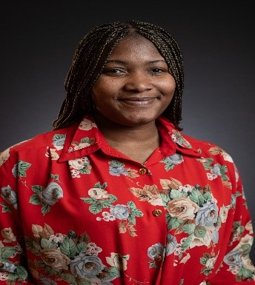
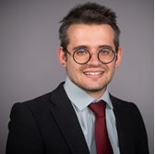
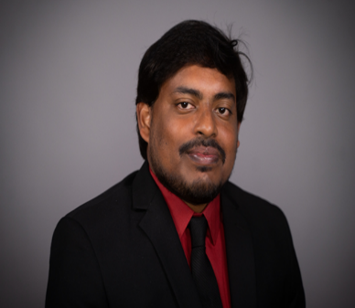
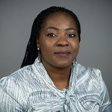
Meet the Team
Group 9
Rhoda Alawiye
Keevin Funderburg
Sai Suresh Marreddy
Oluwatoyin Oniroko

Slide 3
Tech Requirements
Network
Satellite
Link

Slide 4

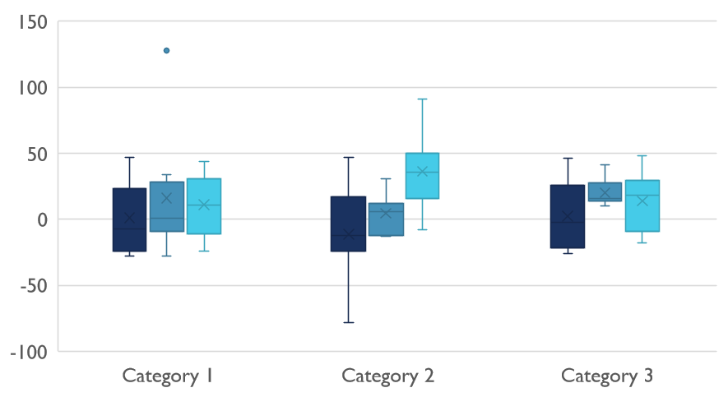
Competitive Landscape

Slide 5

Digital Communications
Cloud
Local
Hybrid

Slide 6

Thank You
someone@example.com

